Slide 1




Purchase Pattern Analytics (Client Project)
Project Team Id : PTID-CDA-DEC-25-958
Project Id : CDACL005
Team Members :
Ankit Raj Sinha
Lolla Venkata Surya Sudheer Kumar
Gangula Padma

Slide 2
Project objective
Understand purchase pattern behavior.
Identify seasonal trends.
Support business decision.

Slide 3
Dataset Overview
Customer transactional dataset
~ 5 lakh records
Features list (Billno, Itemname, Present_date, Quantity, Price, CustomerId, Country)
Time period : 2010 – 2011

Slide 4
Data cleaning(EDA)
Identified and removed duplicated records.
Handled missing values(dropped or removed where necessary)
Identify and treated Outliers in quantity columns using Box plot
Remove invalid transactions(negative quantity/ returns)
Standardize date and change data format of Price and date columns
Prepared clean dataset for analysis

Slide 5
EDA Visualization Overview
Visual analysis performed to understand customer purchase behavior
Key aspects analyzed: product demand, country-wise transactions,
quantity distribution, and revenue trends
.
Visualizations help identify patterns, outliers, and business risks
.
Insights derived from these plots support data-driven decision making

Slide 6
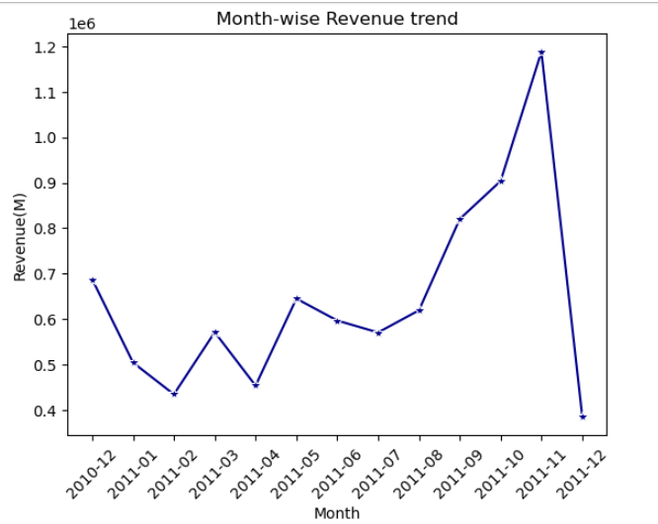
Monthly Revenue Trend
Insights:
From the month of January to May there is inconsistent customer purchasing behavior due to absence of Strong seasonal demand.
A clear upward growth trend from August to November, this growth corresponds to Festive and Holiday seasons.
November records the highest revenue, indicating peak seasonal demand.
Sharp decline in the month of December immediately after a high peak in November shows that customer already spend heavy in the festive season.

Slide 7
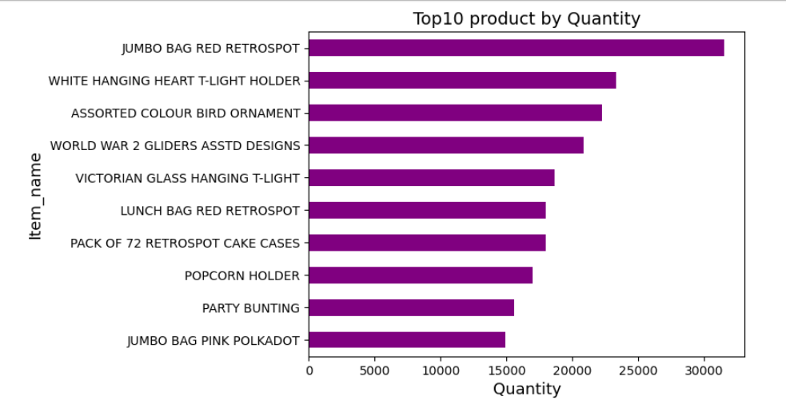
Top 10 product by quantity
Insights:
JUMBO BAG RED RETROSPOT is the highest selling product, indicating very strong purchase demand.
It is followed by WHITE HANGING HEART T-LIGHT HOLDER and ASSORTED COLOUR BIRD ORNAMENT.
These top-selling products should be prioritized for inventory stocking.

Slide 8
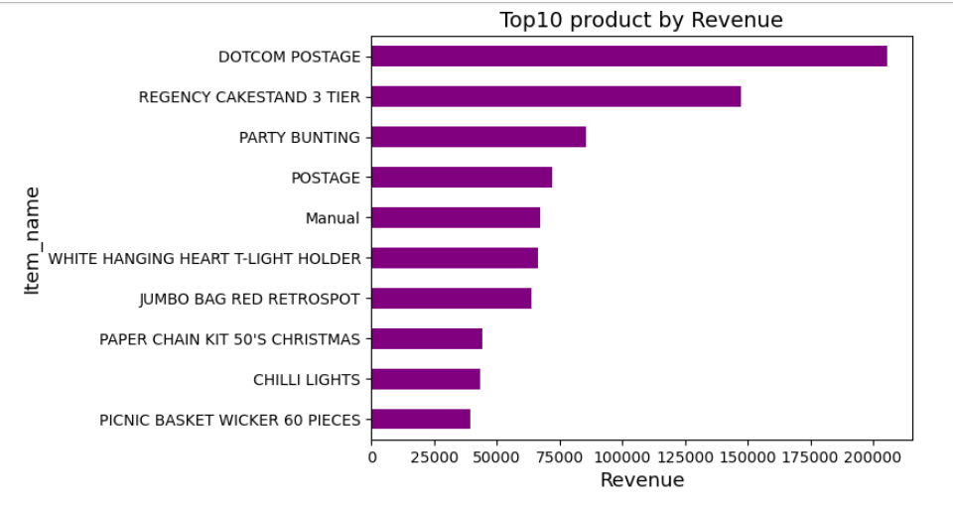
Top 10 product by revenue
Insights:
DOTCOM POSTAGE is the highest revenue generating item followed by REGENCY CAKESTAND 3 TIER and PARTY BUNTING.
By comparing revenue and quantity, different products rank at the top. This indicates that despite lower sales volume, certain products contribute significantly to overall revenue due to higher unit prices.

Slide 9
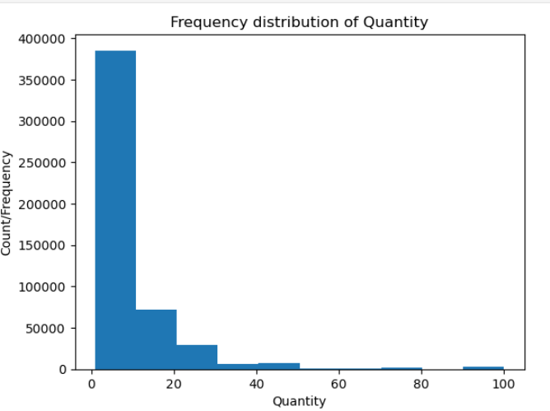
Quantity distribution
Insights:
The distribution is Right Skewed, indicating that most transactions involve low quantity purchase.
Majority of orders fall in the 1-10 quantity range, showing customers usually buy items in small numbers.
High quantity orders are rare, but still present, indicating bulk or wholesale purchase by a small set of customers.

Slide 10
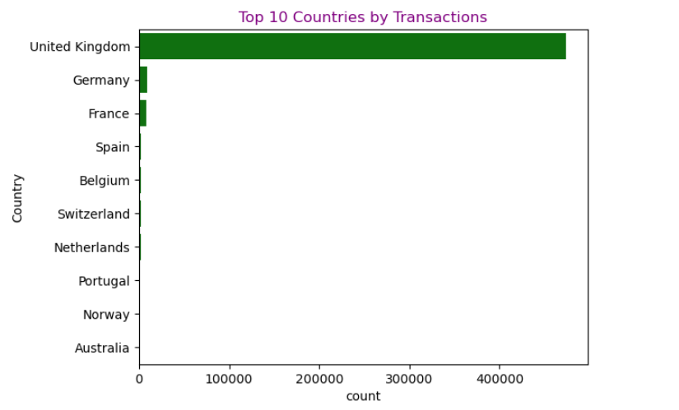
Country-wise Sales
Insights:
The transactions are highly UK centric, indicating business operations are primarily focused on UK market.
There is also a risk factor that the whole business depends on a single country market.

Slide 11
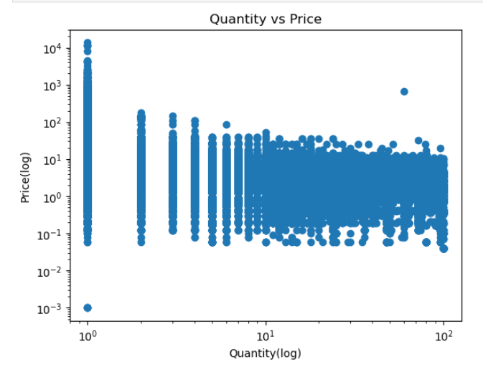
Quantity vs Unit Price Distribution
Insights:
Relationship between Quantity and Price shows inverse trend, as Price increases Quantity decreases.
Customers usually buy less quantity of item's of higher price.
When the price falls in the low-to-medium range, customers tend to purchase higher quantities.

Slide 12
EDA Summary / Key findings
Sales and transactions are highly concentrated in the UK market.
Majority of customers purchase items in small quantities.
Few products contribute significantly to overall revenue.
Presence of outliers due to bulk purchases.

Slide 13
Domain Analysis – Purchase behavior
Customer Behavior
Customers predominantly make low-quantity purchases, indicating a retail-oriented buying behavior
Bulk purchases are limited, possible reason of B2B or wholesale clients.
Product Strategy
Revenue is dependent on a small set of high-performing products.
Opportunity to promote mid-performing products using offers/bundles.
Geographic Risk
Heavy dependency on UK market.
Business risk due to lack of geographic diversification.
Inventory & Operations
Fast-moving products need better stock planning.
Slow-moving items may lead to holding costs.

Slide 14
Business Recommendations
Expand sales strategy beyond the UK to reduce market dependency.
Focus marketing efforts on top revenue-generating products.
Introduce bundle offers to increase average order quantity.
Monitor bulk buyers separately for B2B opportunities.

Slide 15
Conclusion
EDA helped identify key sales patterns and customer behavior.
Domain analysis translated insights into business understanding.
This analysis can support better inventory, marketing, and expansion decisions.

